Slide 1
Decrypting OpenSSH sessions for fun and profit
Jelle Vergeer

Slide 2
Overview
What is SSH?
Protocol overview & encryption
Recovering encryption keys
Decrypting & parsing traffic

Slide 3
What is SSH
Secure Shell (SSH)
Network protocol used for operating network services securely over an unsecured network
Mostly used to manage remote systems
Client – Server model

Slide 4
Protocol overview & encryption
SSH protocol + software version exchange
Algorithm negotiation (KEX INIT)
Key exchange algorithms
Encryption algorithms
MAC algorithms
Compression algorithms
Key Exchange
User authentication
Client requests a channel of type “session”
Client requests a pseudo terminal
Client interacts with session

Slide 5
Recovering encryption keys
Some assumptions and facts
We focused on OpenSSH
Access to network traffic of the SSH session
We assume we have root access to the machine
..or at least access to the memory of the SSH process
Hypervisor Memory snapshot

Slide 6
Recovering encryption keys
Plan of attack
Dive into source code of OpenSSH
Compile OpenSSH ourselves & log keys
Attach a debugger (GDB), search for keys
Success!
Keys are stored on the heap
Kept in memory during the duration of the session

Slide 7
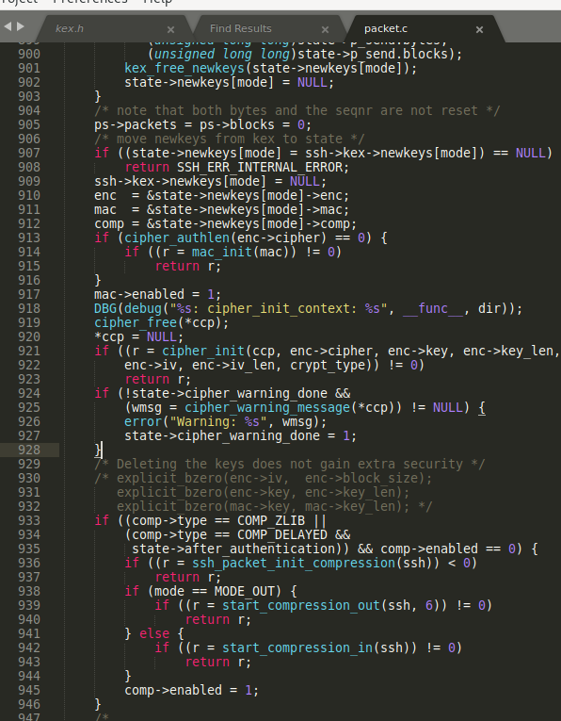

Slide 8
Recovering encryption keys
Plan of attack (2)
Research how keys are stored
Look at the source code/ other implementations
Are there pointers to the key?
Are there structures we can find that reference the key?
sshenc structure!

Slide 9
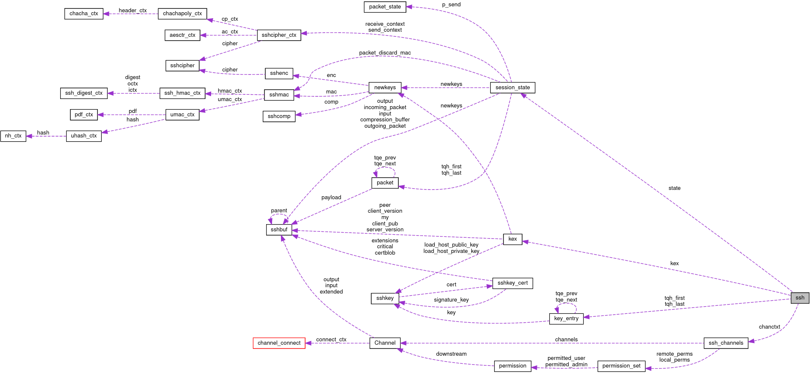

Slide 10
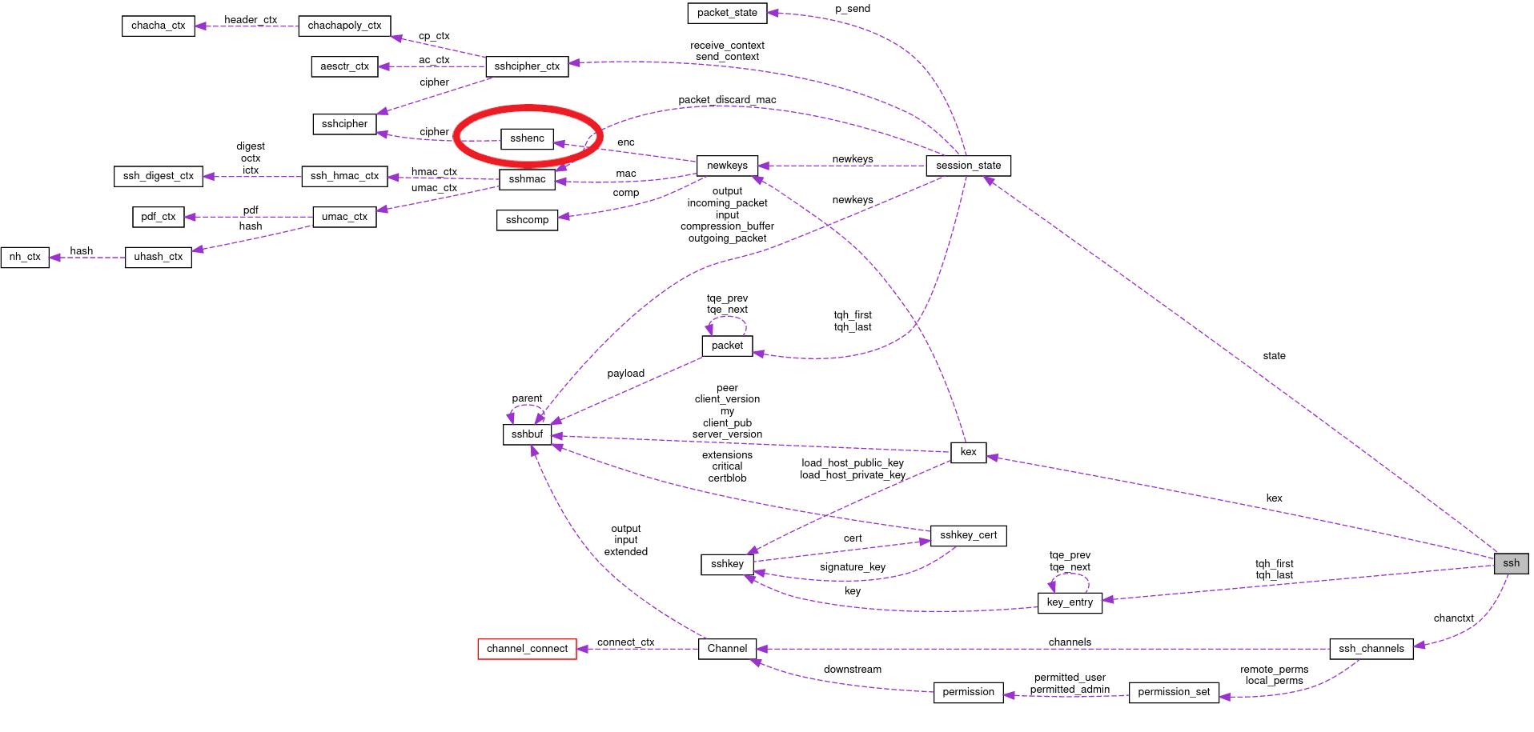

Slide 11
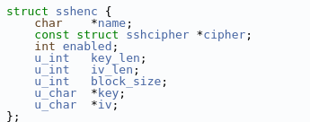
Recovering encryption keys
Definition Value
char* name: 0x808e8a4 -> "chacha20-poly1305@openssh.com"
Cipher* cipher: 0x808e6d0 Cipher{name=0x80989e4 -> "chacha20-poly1305@openssh.com"}
int enabled; 0
u_int key_len; 8-64
u_int iv_len; 12
u_int block_size: 8-16
u_char* key: 0x80989e4 -> "6e4a242303346ecd60209e41b03c438b"
u_char* iv: 0x8088f4e -> "7e59454fbe2247d52d29bd373c3f53ae"

Slide 12
Recovering encryption keys
Plan of attack (3)
Python POC
ptrace
/proc/<pid>/mem
/proc/<pid>/maps
Iterate over ssh(d) processes
Scrape sshenc structures
Read heap
Validate/probe sshenc structure at every offset
Valid structure? -> Success!

Slide 13
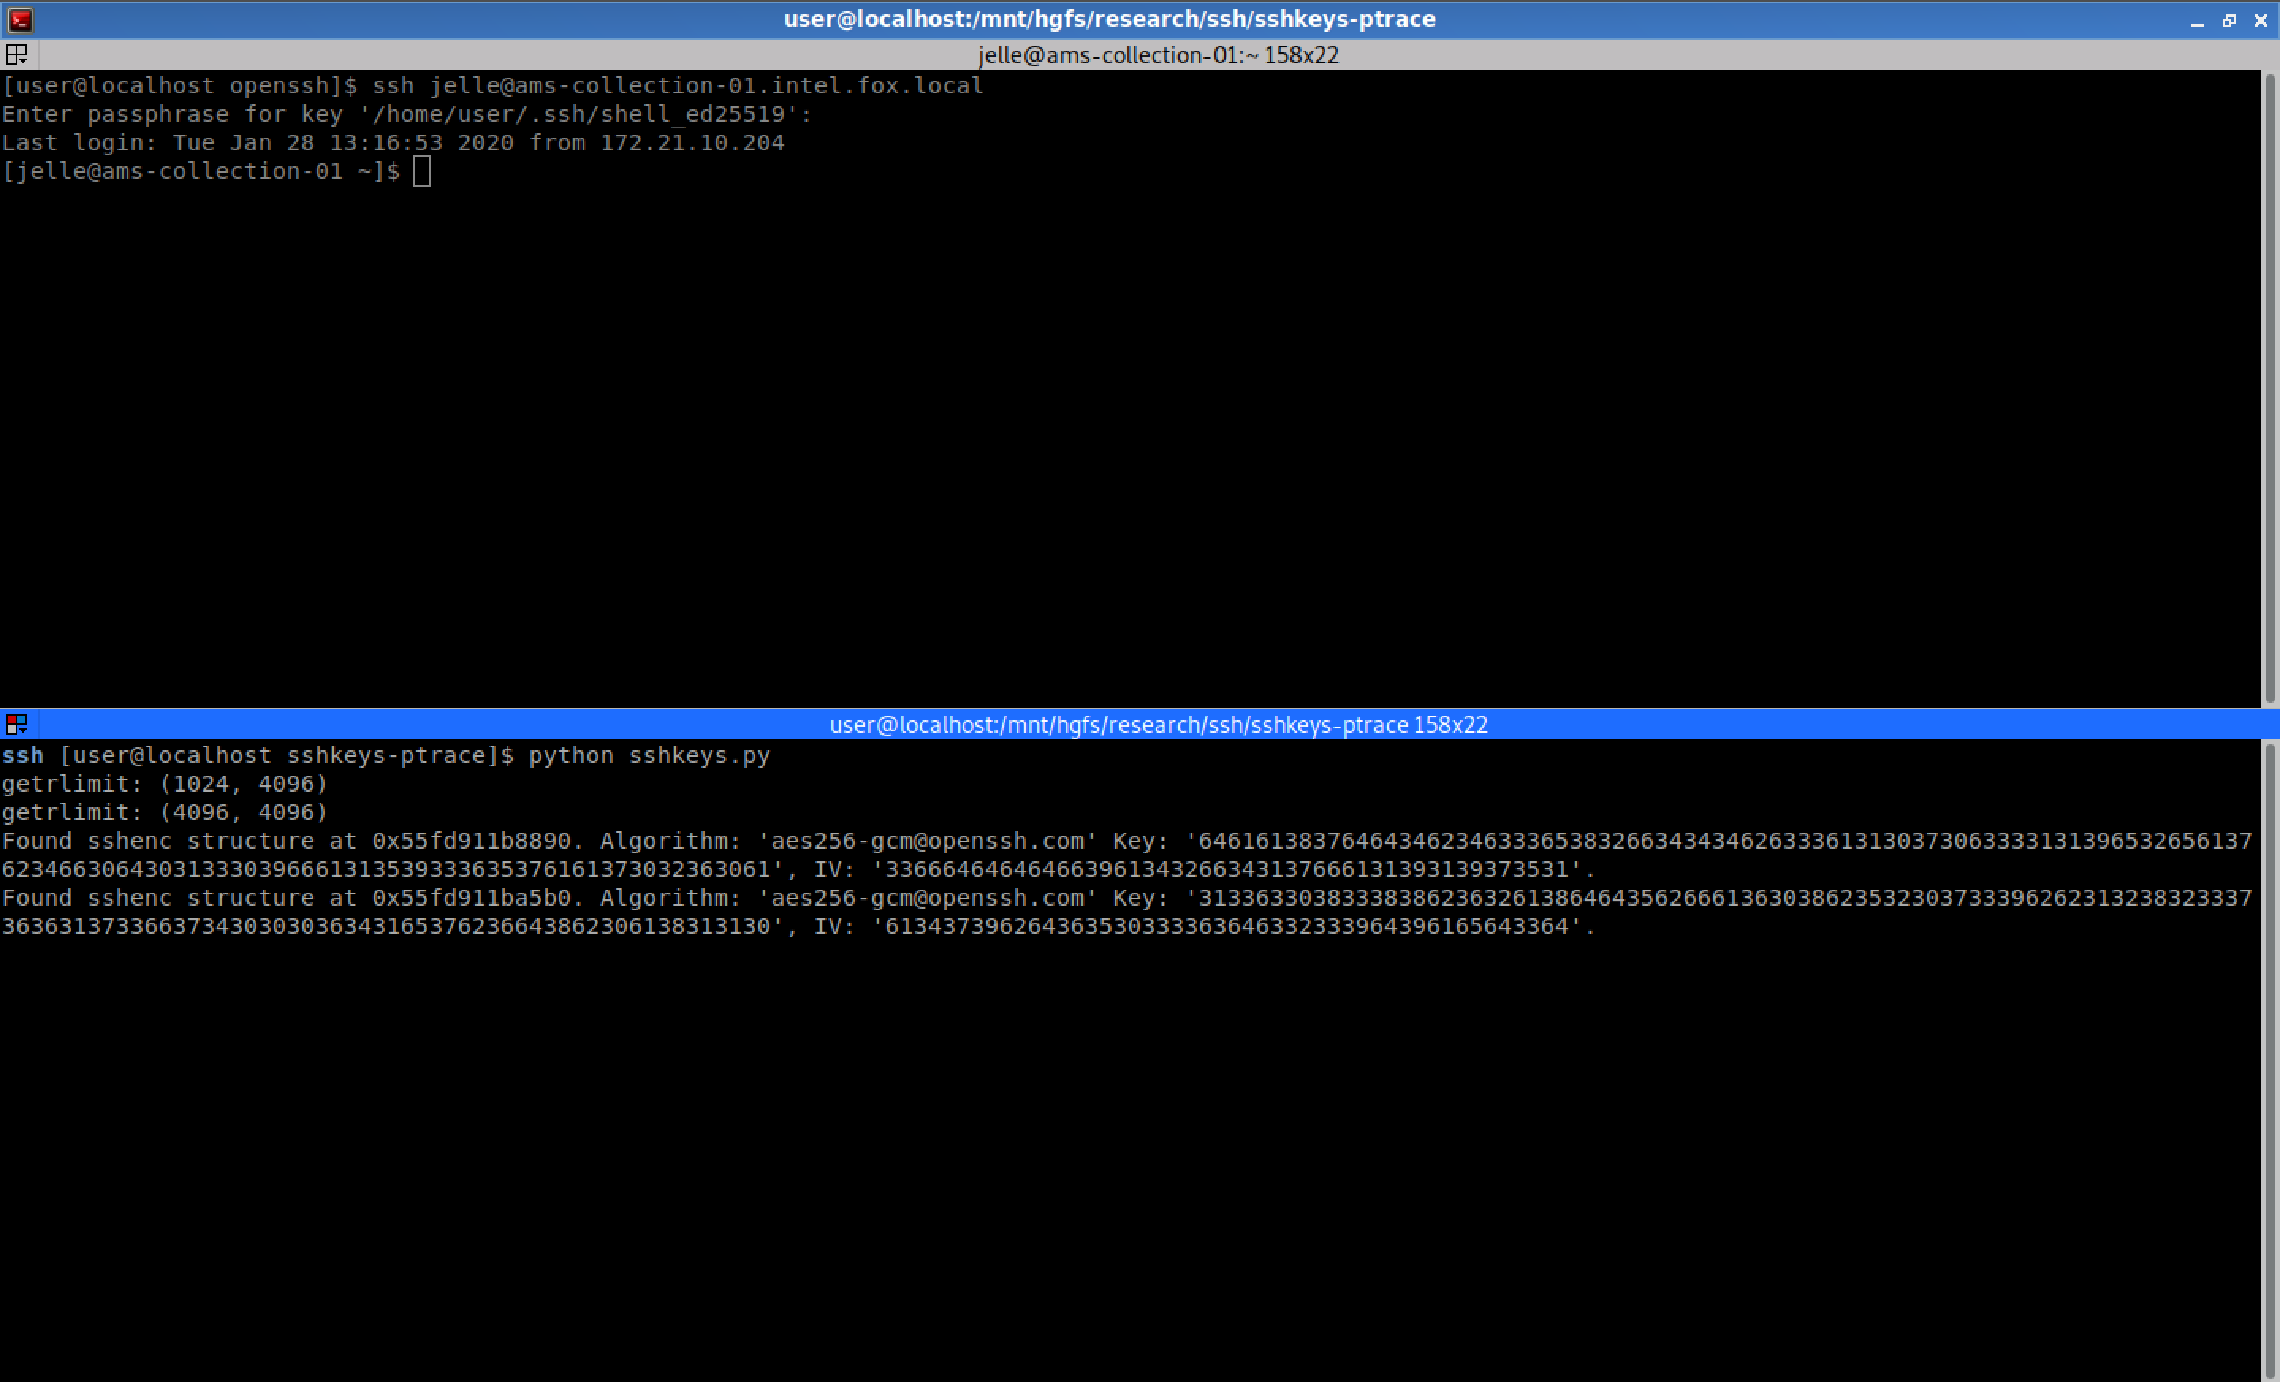

Slide 14
Recovering encryption keys
Plan of attack (4)
Volatility plugin

Slide 15
Decrypting & parsing traffic
Parsing the traffic
Reading lots of RFC’s
pynids for TCP reassembly
Can borrow functionality from asyncssh
Parse messages with dissect.cstruct
When the parser comes across a NEWKEYS message..
Peek the next message and try to decrypt with recovered keys
Decrypt the rest of the traffic with matching key

Slide 16
Protocol overview & encryption
Example stream
TCP
SSH

Slide 17
Protocol overview & encryption
TCP
SSH
Client version info
Client State
SSH Parser
Server State
Client
Client [encrypted]
Server
Server [Encrpyted]

Slide 18
Protocol overview & encryption
TCP
SSH
Server version info
Client State
SSH Parser
Server State
Client
Client [encrypted]
Server
Server [Encrpyted]

Slide 19
Protocol overview & encryption
TCP
SSH
MSG_KEXINIT
Client State
SSH Parser
Server State
Client
Client [encrypted]
Server
Server [Encrpyted]

Slide 20
Protocol overview & encryption
TCP
SSH
MSG_KEXINIT
Client State
SSH Parser
Server State
Client
Client [encrypted]
Server
Server [Encrpyted]

Slide 21
Protocol overview & encryption
TCP
SSH
MSG_KEXDH_INIT
Client State
SSH Parser
Server State
Client
Client [encrypted]
Server
Server [Encrpyted]

Slide 22
Protocol overview & encryption
TCP
SSH
MSG_KEXDH_REPLY
Client State
SSH Parser
Server State
Client
Client [encrypted]
Server
Server [Encrpyted]

Slide 23
Protocol overview & encryption
TCP
SSH
MSG_NEWKEYS
Client State
SSH Parser
Server State
Client
Client [encrypted]
Server
Server [Encrpyted]

Slide 24
Protocol overview & encryption
TCP
SSH
MSG_SERVICE_REQUEST
Client State
SSH Parser
Server State
Client
Client [encrypted]
Server
Server [Encrpyted]

Slide 25
Protocol overview & encryption
TCP
SSH
MSG_NEWKEYS
Client State
SSH Parser
Server State
Client
Client [encrypted]
Server
Server [Encrpyted]

Slide 26
Protocol overview & encryption
TCP
SSH
MSG_IGNORE
Client State
SSH Parser
Server State
Client
Client [encrypted]
Server
Server [Encrpyted]

Slide 27
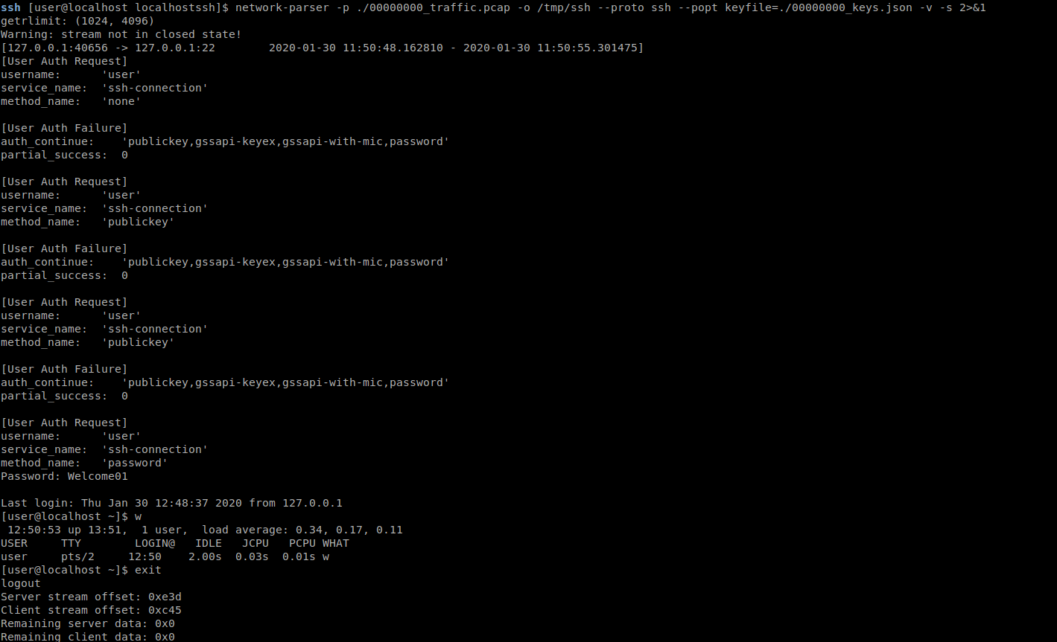
Decrypting traffic
<screenshot of network-parser>
Default mode

Slide 28
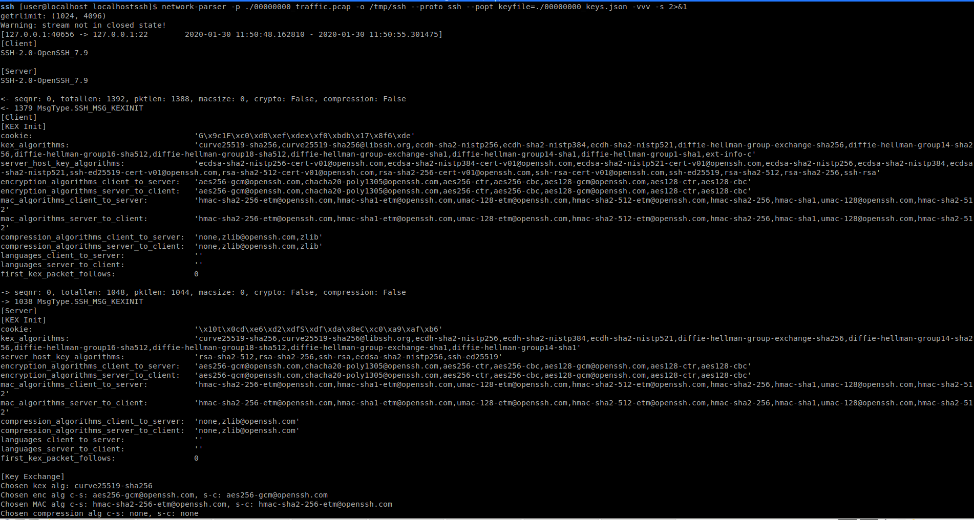
Decrypting traffic
<screenshot of network-parser>
Extra verbose

Slide 29
So…
Be aware giving me root access somewhere ☺
We can reconstruct incoming and outgoing SSH connections…
Harvest passwords and secrets
Gain knowledge of executed commands and output
Transferred files
Tunneled traffic
(at least) compatible with OpenSSH 4.3 - 8.0
Tested on Debian 5
CentOS 7
Fedora 29

Slide 30
Use cases
Useful in…
Forensics
Red Team
Threat Intelligence

